Slide 1

CRM Data Engineering and Analysis Pipeline
by Mansi Mishra
MM

Slide 2
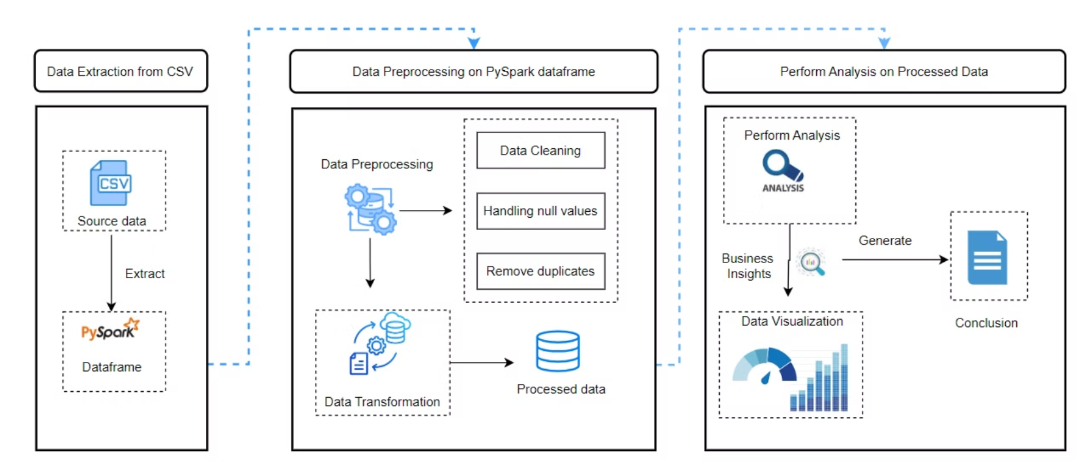
Architecture Diagram

Slide 3
Data Accuracy and Integrity
Validate and ensure that CRM data is accurate, consistent, and correctly linked across multiple datasets.
Data Loading
Initial Data Display
Validation Logic
Load multiple CSV files into PySpark DataFrames.
Show the first few records from each dataset.
Check for the presence of corresponding IDs between two datasets.
Validation Process
Iterate over predefined validation rules.

Slide 4
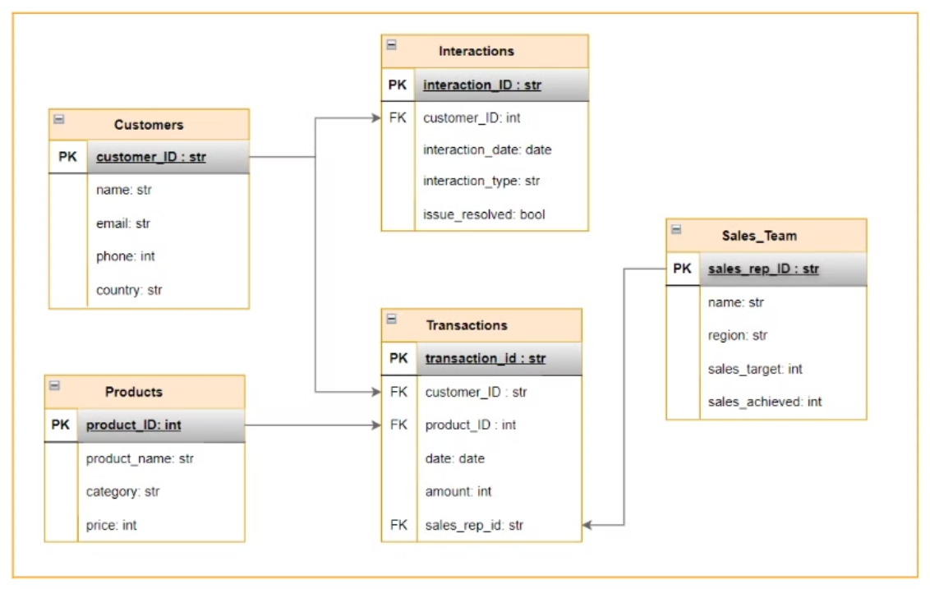
ER Diagram

Slide 5

Customer Purchase Behavior Analysis
Analyze customer interactions with products and services to understand spending patterns, purchase frequency, and geographic influences.
1
Total Spending
Sum up the Amount column to get the total amount spent by each customer.
2
Average Transaction Amount
Average the Amount values for each customer to find their typical transaction value.
3
Purchase Frequency
Count the number of transactions to determine how often each customer makes a purchase.
4
Customer Segmentation
Segment customers by country and assess how geographic location impacts their purchasing patterns.

Slide 6
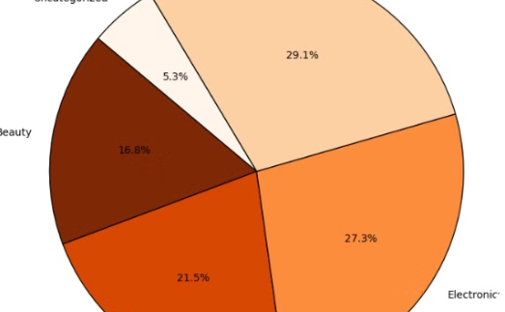
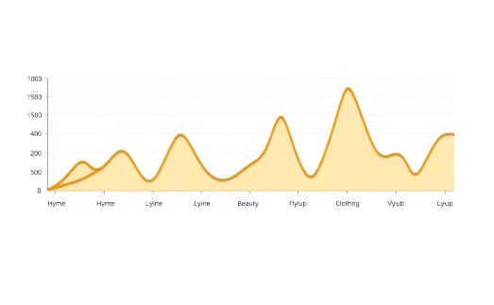
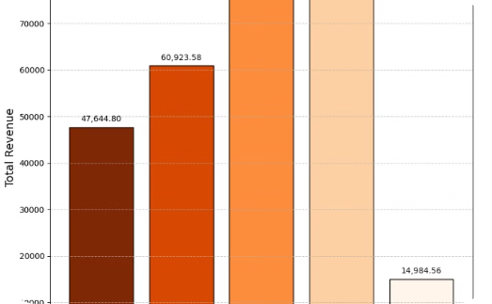
Product Sales Performance Evaluation
Revenue Distribution
Trend Analysis
Category Performance
Analyze product categories to identify areas of high revenue generation and those with potential for improvement. Focus on key metrics like revenue share, average purchase value, and sales volume.
Monitor sales trends over time to identify seasonal fluctuations, popular products, and emerging customer preferences.
Evaluate the performance of each product category based on revenue, sales volume, and customer engagement. Identify high-performing categories and those requiring attention.

Slide 7

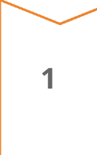
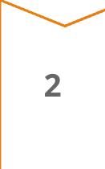
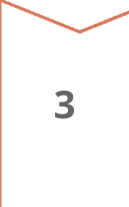
Customer Interaction Effectiveness
Evaluate the success of various customer interaction methods in resolving issues and improving satisfaction.
Merge Interactions with Customer Data
Merge interactions with customers on CustomerID to analyze interaction data in the context of customer demographics.
Interaction Type Analysis
Group interactions by InteractionType and calculate the total number of interactions for each type.
Visualization
Join interaction counts and resolution rates into a single DataFrame.

Slide 8

Sales Team Performance Assessment
Analyze sales team performance to identify high performers and those who require additional support.
Sales Achieved
Sales Target
Performance Ratio
Classification
100
100
1
High Performer
80
100
0.8
Underperformer

Slide 9

Data Cleaning and Preprocessing
This project successfully implements a robust data cleaning and preprocessing workflow to prepare multiple datasets related to sales and customer interactions for further analysis.
1
Missing Values
Handling missing numeric values with calculated averages.
2
Duplicates
Resolving anomalies like negative sales values and duplicate records.
3
Data Validation
Standardizing text fields, and validating date and boolean fields.

Slide 10



Conclusion
The cleaned and preprocessed data now serves as a solid foundation for analysis, supporting key business processes like sales performance evaluation and customer relationship management.
Data Accuracy
Ensures that the datasets are accurate, consistent, and ready for insightful analysis.
Actionable Insights
Sets the stage for more accurate and actionable insights, contributing to better strategic decision-making.

